Slide 1
CHAPTER FOUR
JAVA DATABASE PROGRAMMING

Slide 2
Contents
Connecting Java application to Database System
Creating and executing statements
Working on populated data/Result set

Slide 3
Java Database Connectivity
An API that lets you access virtually any tabular data source from the Java programming language
is a Java feature that lets you
connect to almost any relational database system,
execute SQL commands, and
process the results all from within a Java program
JDBC provides Java applications with access to most database systems via SQL
ODBC is a generic database connection standard that almost every database program available can speak to.
It’s inherently inefficient, but it is easy to set up and performs adequately for small applications and for testing purposes. E.g. Java to MS Access

Slide 4
Java Database Connectivity
In its simplest form, JDBC makes it possible to do the following:-
Connect to a database
Execute SQL statements to query your database
Generate query results
Perform updates, inserts and deletions
Execute Stored Procedures
The benefits of using JDBC include the following:-
A developer only needs to write one API to access any relational database
There is no need to rewrite code for different databases
There is no need to know the database vendor's specific APIs
It provides a standard API and is vendor independent
Almost every database vendor has some sort of JDBC driver

Slide 5
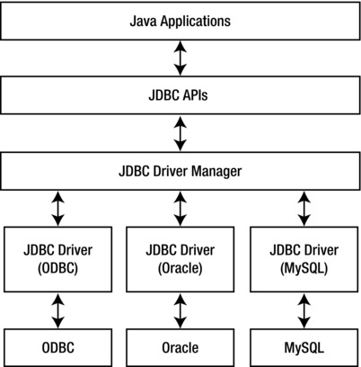
JDBC Architecture
The JDBC architecture consists of two layers:
first, the JDBC API, which supports Java application-to-JDBC Driver Manager communications and
secondly the JDBC Driver API, which handles Driver Manager-to-Database communications.

Slide 6
JDBC drivers
JDBC drivers are available for most database platforms and from a number of different vendors.
There are four different driver types as follows:
Type 1 - JDBC-ODBC Bridge
Type 2 - JDBC-Native Bridge
Type 3 - JDBC-Net Bridge
Type 4 - Direct JDBC Driver
Type 1 only runs on platforms where ODBC is available
ODBC must be configured separately
Type 2 Drivers map between a proprietary Database API and the JDBC API
Type 3 Drivers are used with middleware products
Type 4 Drivers are written in Java
In most cases, type 4 drivers are preferred

Slide 7
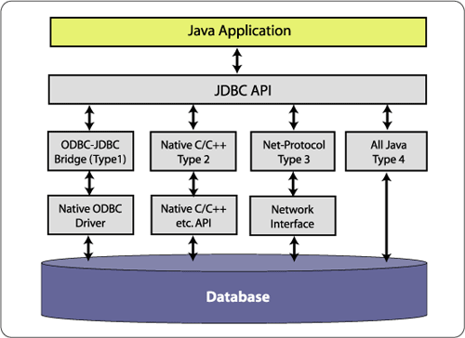
JDBC drivers …
The following diagram shows the JDBC architecture options using the different driver types:

Slide 8
Connecting to a Database
Steps to using a database query:
Load a JDBC “driver”
Connect to the data source
Send/execute SQL statements
Process the results
Close/dispose connection/objects

Slide 9
The JDBC Interfaces
Loading drivers
Establishing connections
Creating and executing statements
Processing ResultSet

Slide 10

JDBC Driver
Acts as the gateway to a database
Not actually a “driver”, just a .jar file
Java application
Database Server
JDBC Driver

Slide 11
JDBC Driver Management
All drivers are managed by the DriverManager class
Example - loading an Oracle JDBC driver:
In the Java code: Class.forName(“oracle.jdbc.driver.OracleDriver”)
Driver class names:
Oracle: oracle.jdbc.driver.OracleDriver
MySQL: com.mysql.jdbc.Driver
MS SQL Server:
com.microsoft.jdbc.sqlserver.SQLServerDriver
MS Access
sun.jdbc.odbc.JdbcOdbcDriver Already in JDK

Slide 12
Developing JDBC Programs
Loading drivers
Establishing connections
Creating and executing statements
Processing ResultSet
Connection connection = DriverManager.getConnection(databaseURL);
Database URL Pattern
Access jdbc:odbc:dataSource
MySQL jdbc:mysql://hostname:port/dbname?user=<uname>&password=<password>
Oracle jdbc:oracle:thin:@hostname:port#:oracleDBSID
Examples:
For Access:
Connection connection = DriverManager.getConnection
("jdbc:odbc:ExampleMDBDataSource");
For MySQL:
Connection connection = DriverManager.getConnection
("jdbc:mysql://localhost/test?user=root&password=1234");
For Oracle:
Connection connection = DriverManager.getConnection
("jdbc:oracle:thin:@localhostu:1521:orcl", "scott", "tiger");

Slide 13
Establishing a Connection
Create a Connection object
Use the DriverManager to grab a connection with the getConnection method
Necessary to follow exact connection syntax
the parameter syntax for getConnection varies between JDBC drivers
one driver can have several different legal syntaxes

Slide 14
Establishing a Connection (cont.) MySQL Example
Connection con = DriverManager.getConnection(string);
what to supply for string ?
“jdbc:mysql://<URL>:3306/<DB>?user=<user>&password=<pw>”
Driver
URL
Port
DB Name
Username
Password

Slide 15
Connecting to a database
private static Connection getConnection()
{
Connection con = null;
try
{
Class.forName(“com.mysql.jdbc.Driver”);
String url = “jdbc:mysql://localhost/SISDB”;
String user = “root”;
String pw = “1234”;
con = DriverManager.getConnection(url, user, pw);
}
catch (ClassNotFoundException e)
{
System.out.println(e.getMessage());
System.exit(0);
}
catch (SQLException e)
{
System.out.println(e.getMessage());
System.exit(0);
}
return con;
}

Slide 16
Querying a Database
Connection
the Connection class has two methods
Close method closes the connection, and
The createStatement method returns a Statement object,
Statement
Used for executing SQL statements against the database
executeQuery method
executeUpdate method
execute method
Obtain a statement object from the connection:
Statement stmt = con.createStatement ();
Execute the SQL statements:
stmt.executeUpdate(“update table set field=‘value’”);
stmt.executeUpdate(“INSERT INTO mytable VALUES (1, ‘name’)”);
stmt.executeQuery(“SELECT * FROM mytable”);
PreparedStatement
An SQL statement (which can contain parameters) is compiled and stored in the database
CallableStatement
Used for executing stored procedures

Slide 17
Connection and Statement Methods
void close()
statement createStatement()
Statement createStatement(int type, int concur)
ResultSet executeQuery(String sql)
ResultSet executeQuery(String sql)
int executeUpdate(String sql)
Parameter of the createStatement method
The first specifies the type of result set that is created, and can be one of the following:
ResultSet.TYPE_FORWARD_ONLY
ResultSet.TYPE_SCROLL_INSENSITIVE
ResultSet.TYPE_SCROLL_SENSITIVE
The second indicates whether the result set is read-only or updatable, and can be one of the following:
ResultSet.CONCUR_READ_ONLY
ResultSet.CONSUR_UPDATABLE

Slide 18
Retrieving Data
ResultSet
Represents the result of an SQL statement; rows returned from a query
provides methods you can use to move from row to row and to get the data for a column.
DatabaseMetaData
Provides access to a database's system catalogue
ResultSetMetaData
Provides information about the data contained within a ResultSet
ResultSet rs = stmt.executeQuery(“SELECT id,name FROM employees where id = 1000”)
Some methods used in ResultSet:
next()
getString()
getInt()

Slide 19
Navigation Methods of the ResultSet
void close()
void last():
int getRow()
boolean next()
void last()
boolean isLast()
boolean isFirst()
void previous()
void afterLast()
void beforeFirst()
boolean isBeforeFirst()
boolean isAfterLast()
absolute(int row)
relative(int row)

Slide 20
Get Methods of the ResultSet
boolean getBoolean(String columnName)
boolean getBoolean(int columnIndex)
Date getDate(String columnName)
Date getDate(int columnIndex)
double getDouble(String columnName)
double getDouble(int columnIndex)
float getFloat(String columnName)
float getFloat(int columnIndex)
int getInt(String columnName)
int getInt(int columnIndex)
long getLong(String columnName)
long getLong(int columnIndex)
short getShort(String columnName)
short getShort(int columnIndex)
String getString(String columnName)
String getString(int columnIndex)

Slide 21
Scrollable and Updatable Result Sets
The most useful improvements in JDBC 2 are in the ResultSet class
Until the release of JDBC2.1 the virtual curser could only be moved down the ResultSet object.
But now the virtual cursor can be moved backwords or even positioned at a specific row.
Also we can modify the values of resultset.
To obtain scrolling result sets from your queries, you must obtain a different Statement object with the method Statement stat = conn.createStatement(type, concurrency);

Slide 22
Cont’d…….
Three ways in which a ResultSet can be changed, by
updating value of a row,
deleting a row and
inserting a new row.
Once we get the ResultSet the updateXXX() method is used to change the value of a row of ResultSet.
This method takes two arguments,
first either the name or number of the column of the ResultSet that is to be updated and
the second is the new value that will replace the old.
The value can be set to null by calling updateNull() method.
It requires one parameter which is number of the column in the current row of the ResultSet.
The updateRow() method is called after updateXXX() method.
It changes the values of the column of current row based on the values of updateXXX() method.
The deleteRow() method is used to delete a row.
To insert a new row moveToInsertRow() method is there.
Then set all the fields by updateXXX() method.
After that insertRow() should be called to insert the row.

Slide 23
Cont’d…….
There are other methods of ResultSet object that are used to position the virtual cursor in addition to next().
Those are
first()- moves the curser to first row.
last()- moves the curser to the last row.
previous()-moves the curser to the previous row.
absolute()-moves to a specific row as the parameter passed
relative()-moves to a row relative to another row
getRow()-returns the current row number.
afterLast() - Moves the cursor to the end of this ResultSet object, just after the last row
beforeFirst() - Moves the cursor to the front of this ResultSet object, just before the first row
cancelRowUpdates() - Cancels the updates made to the current row in this ResultSet object
moveToCurrentRow() - Moves the cursor to the remembered cursor position, usually the current row
refreshRow() - Refreshes the current row with its most recent value in the database

Slide 24
Cont’d…….
Find whether ResultSet is scrollable:
Some JDBC drivers may not support all these features and therefore they are unable to return a scrollable ResultSet.
To know about it, boolean forward,sensitive,insensitive; Forward=DatabaseMetaData.supportsResultSetType(TYPE_FOREWARD_ONLY); sensitive=DatabaseMetaData.supportsResultSetType(TYPE_SCROLL_SENSITIVE); Forward=DatabaseMetaData.supportsResultSetType(TYPE_SCROLL_INSENSITIVE);

